Slide 1
Migration Tool Kit for Virtualization
References:
1.https://www.opensourcerers.org/2024/06/21/openshift-virtualization/
2.https://opensource.com/article/21/6/migrate-vms-kubernetes-forklift
3.https://docs.redhat.com/en/documentation/migration_toolkit_for_virtualization/2.6/html-single/release_notes/index#rn-26_release-notes

Slide 2
MTV
Migrate multiple VMs from a compatible hypervisor.
  VMware vSphere
  Red Hat Virtualization (RHV)
  OpenStack
  Open Virtual Appliances (OVAs) that were created by VMware vSphere
  Remote OpenShift Virtualization clusters
MTV Operator
Latest version 2.6
Forklift is the upstream version.
Namespace: openshift-mtv
Can migrate VMs to an OpenShift Virtualization cluster only

Slide 3
MTV provides two migration types: cold migration and warm migration
Cold migration
Cold migration is the default migration type.
The source VM is shut down, and then the data is transferred to the target OpenShift cluster. After the transfer is complete, the VM is powered on, in OpenShift Virtualization.
Warm migration
Warm migration handles the migration in two stages:
The precopy stage uses snapshots on the source VM provider to copy the VM data while the VM is running.
The cutover stage shuts down the VM and copies the remaining data to the target cluster.
The VM is then started on OpenShift Virtualization. You can manually start the cutover stage from the web console, or you can schedule a cutover time in the migration plan.

Slide 4
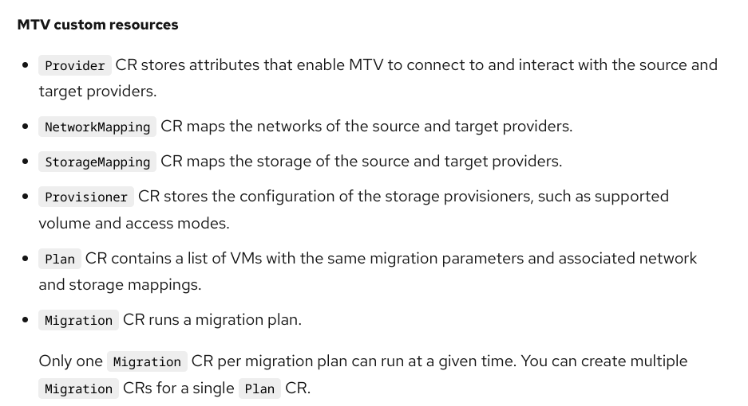

Slide 5
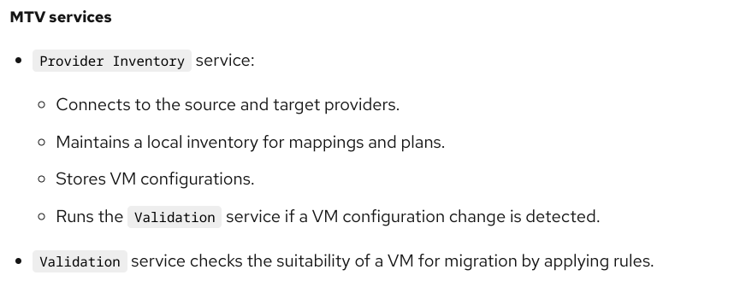
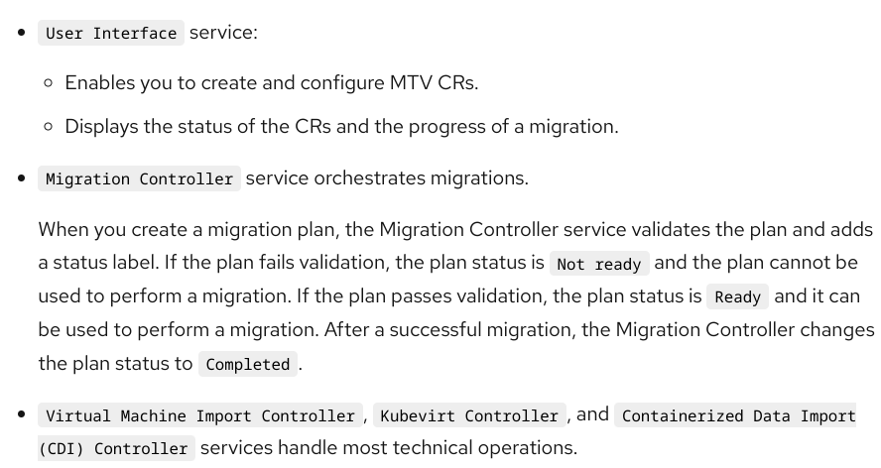

Slide 6
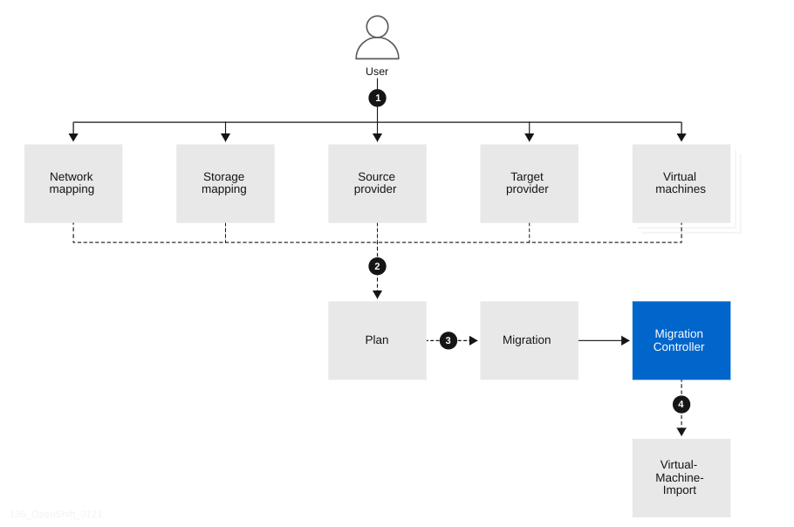
High-level migration workflow

Slide 7
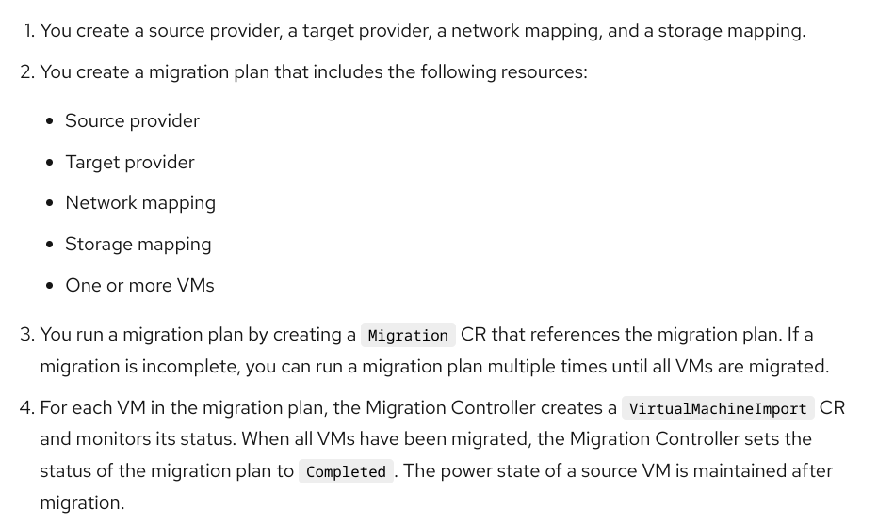

Slide 8
Detailed OpenShift Virtualization migration workflow
When you run a migration plan, the Migration Controller creates a VirtualMachineImport custom resource (CR) for each source VM.
The Virtual Machine Import Controller validates the VirtualMachineImport CR and generates a VirtualMachine CR.
The Virtual Machine Import Controller retrieves the VM configuration, including network, storage, and metadata, linked in the VirtualMachineImport CR.
For each VM disk:
The Virtual Machine Import Controller creates a DataVolume CR as a wrapper for a Persistent Volume Claim (PVC) and annotations.
The Containerized Data Importer (CDI) Controller creates a PVC. The Persistent Volume (PV) is dynamically provisioned by the StorageClass provisioner.
The CDI Controller creates an Importer pod.
The Importer pod connects to the VM disk by using the VMware Virtual Disk Development Kit (VDDK) SDK and streams the VM disk to the PV.
After the VM disks are transferred:
The Virtual Machine Import Controller creates a Conversion pod with the PVCs attached to it.
The Conversion pod runs virt-v2v, which installs and configures device drivers on the PVCs of the target VM.
The Virtual Machine Import Controller creates a VirtualMachineInstance CR.
When the target VM is powered on, the KubeVirt Controller creates a VM pod.
The VM pod runs QEMU-KVM with the PVCs attached as VM disks.

Slide 9
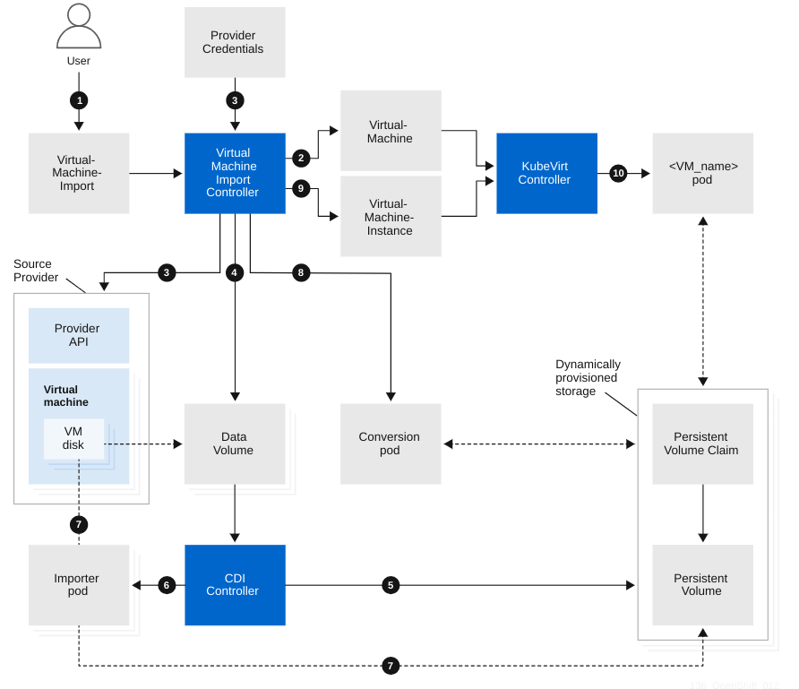

Slide 10
To clean up the temporary resources that the MTV creates during the migration, such as the migration pods and temporary PVCs, you must archive the migration plan.
Removing a migration plan does not clean up temporary resources.
Temporary migration resources might prevent some VM operations such as VM snapshots.

